Slide 1
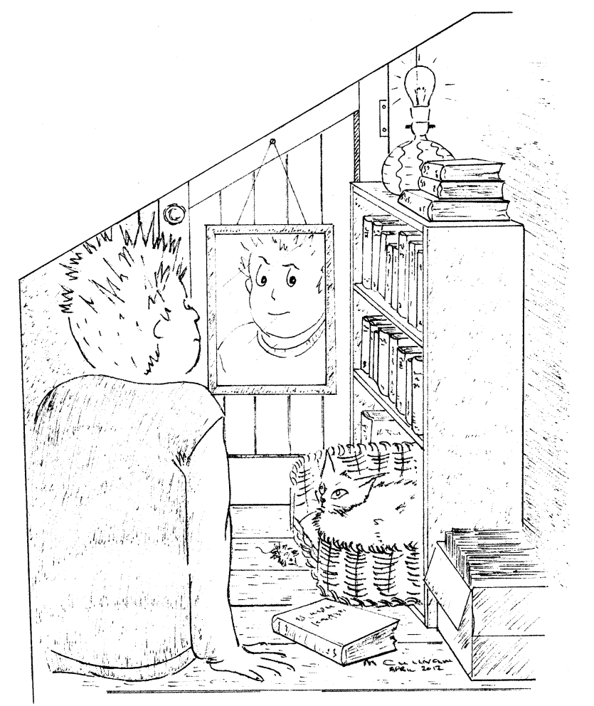
In the dark
Imagine you go into a cupboard under the stairs and close the door. There are no windows. The door is a very tight fit so no light can get in.
On the shelves are some books.
The cat is in her basket looking at you.
You can see yourself in the mirror.

Slide 2
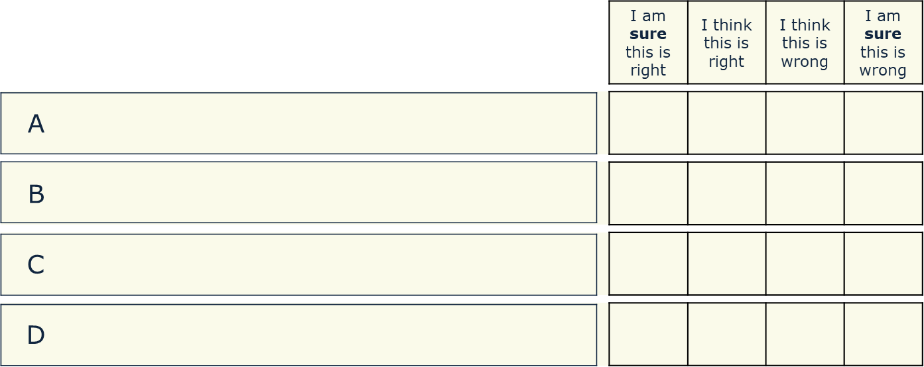
In the dark
You switch off the light.
After ten minutes, what will you be able to see?
You can see everything, but it is very dim.
You can only see the cat’s eyes.
They are shining.
You can only see the mirror.
It is shining dimly.
You can’t see anything at all.

